Slide 2
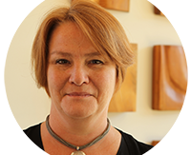
What we do in Advocacy
Ramona Hattendorf Director of Advocacy
Help people understand what is going on
Help people connect with elected officials and other civic leaders to share how decisions affect their lives
Goal: Informed public policy and investments for a strong, stable safety net and inclusive communities
Public policy = 1. Support/laws for public, and 2. Informed BY the public
rhattendorf@arcofkingcounty.org
206.829.7048
“Systems advocacy”

Slide 3
Washington has a BIG budget gap
This means the state does not have the money to pay for the support people need.
Updated 10/20/2020

Slide 4
No Money = Cuts to Supports
The state relies on money from taxes to pay for schools, healthcare, housing and food aid, disability supports, and more

Slide 5
Big Problem
When everyone had to stop working and stay home, it meant they did not buy things, and the state didn’t collect as much in taxes.
This problem affects all kinds of support. But right now, we are most worried about cuts to disability supports

Slide 6
#IAmNotOptional
Not clear what action, if any, will be taken on the CURRENT budget. It has a $1.4 billion gap.
Agencies submitted their asks for the NEXT budget to the governor. They were told (again) to identify 15% in savings. For DDA, that means about $601 million cut. For ALTSA, $1.1 billion

Slide 7
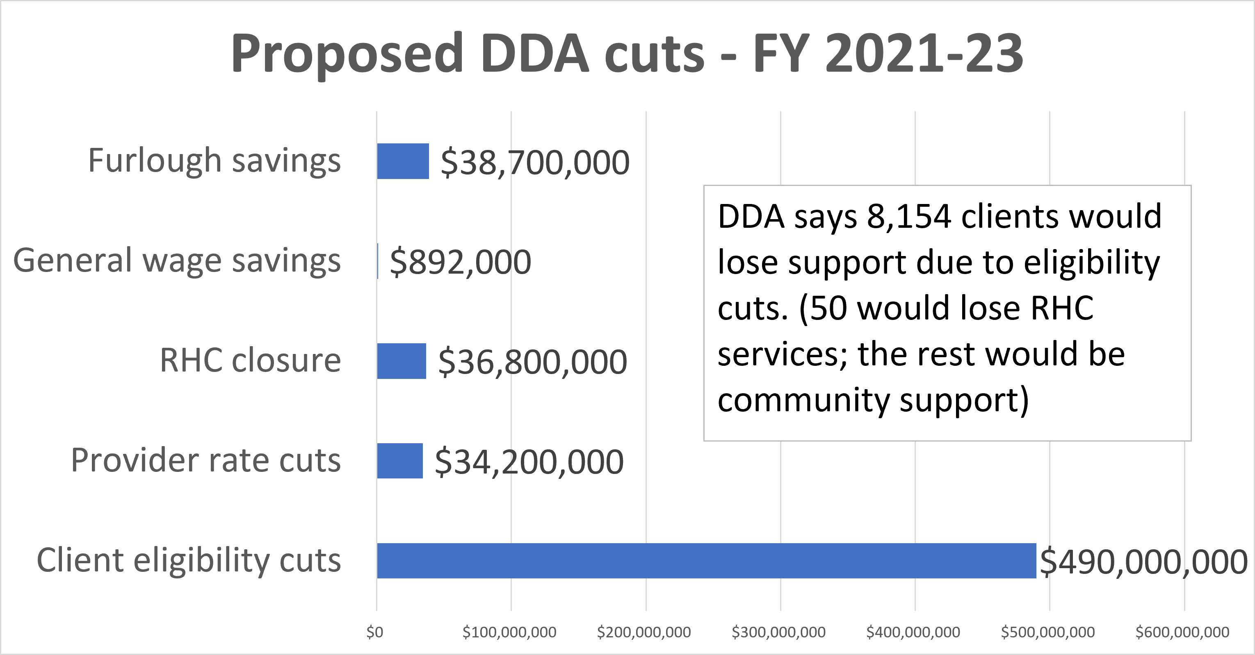
DDA budget letter: https://arcofkingcountyvoice.blogspot.com/2020/09/dda-budget-request-for-fy-2021-23.html

Slide 8
ALTSA budget letter: https://arcofkingcountyvoice.blogspot.com/2020/09/altsa-budget-request-for-fy-2021-23.html
ALTSA says 12,000 clients would lose service

Slide 9
It’s Not a Service. It’s My Life
The proposed cut that most alarms us is changing the eligibility requirements for long-term services.
That means people could lose the support they need to live in the community

Slide 10
For People with Disabilities, This Could Mean:
Losing your job, and connections to friends
Losing mobility, and being hospitalized
Losing your home, because you can’t live independently
More people may experience health crisis
More families may face economic crises
Community supports are a lifeline

Slide 11
It is not clear who is most at risk under the DDA scenario. DDA said it looked at subfactors and tried to protect some. But ultimately their eligibility change was based on how much they had to cut.
There seems to be an assumption that people who need more types of care are more vulnerable (say 3, instead of 2). Certain factors appear to have more weight than others. It is not clear what those factors are
NOTE: Some DDA clients also have ALTSA support. Adult Family Homes are through ALTSA. In ALTSA proposed cuts, 305 DDA clients living in an AFH would lose their AFH eligibility
DDA RATIONALE

Slide 13
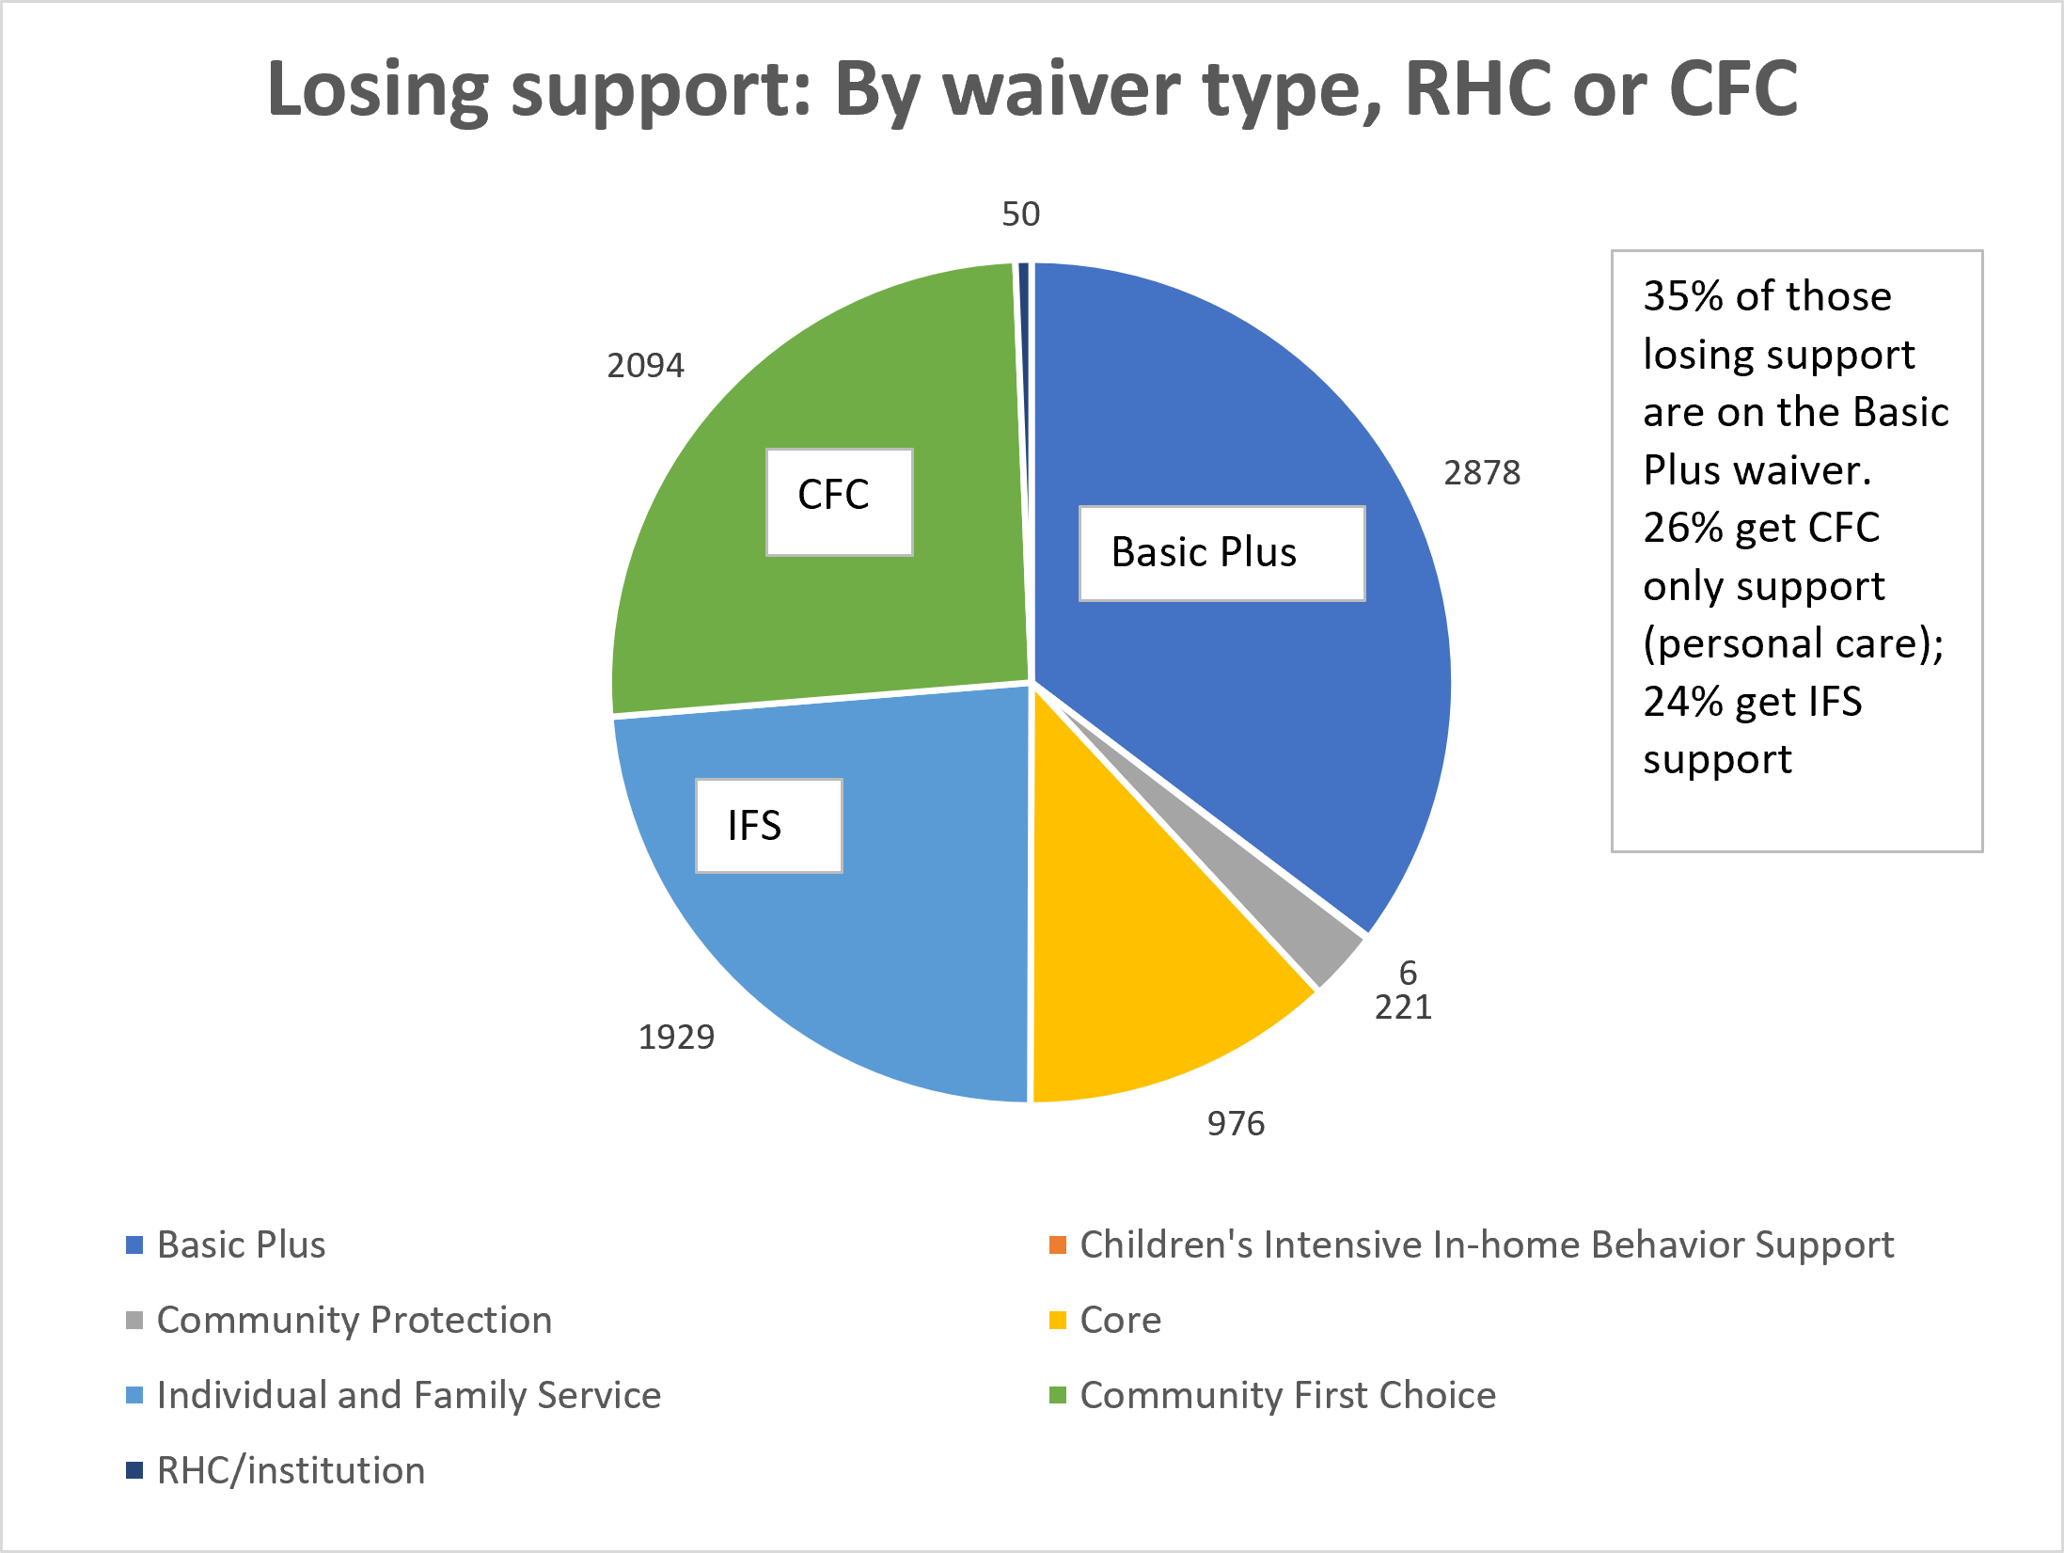

Slide 14
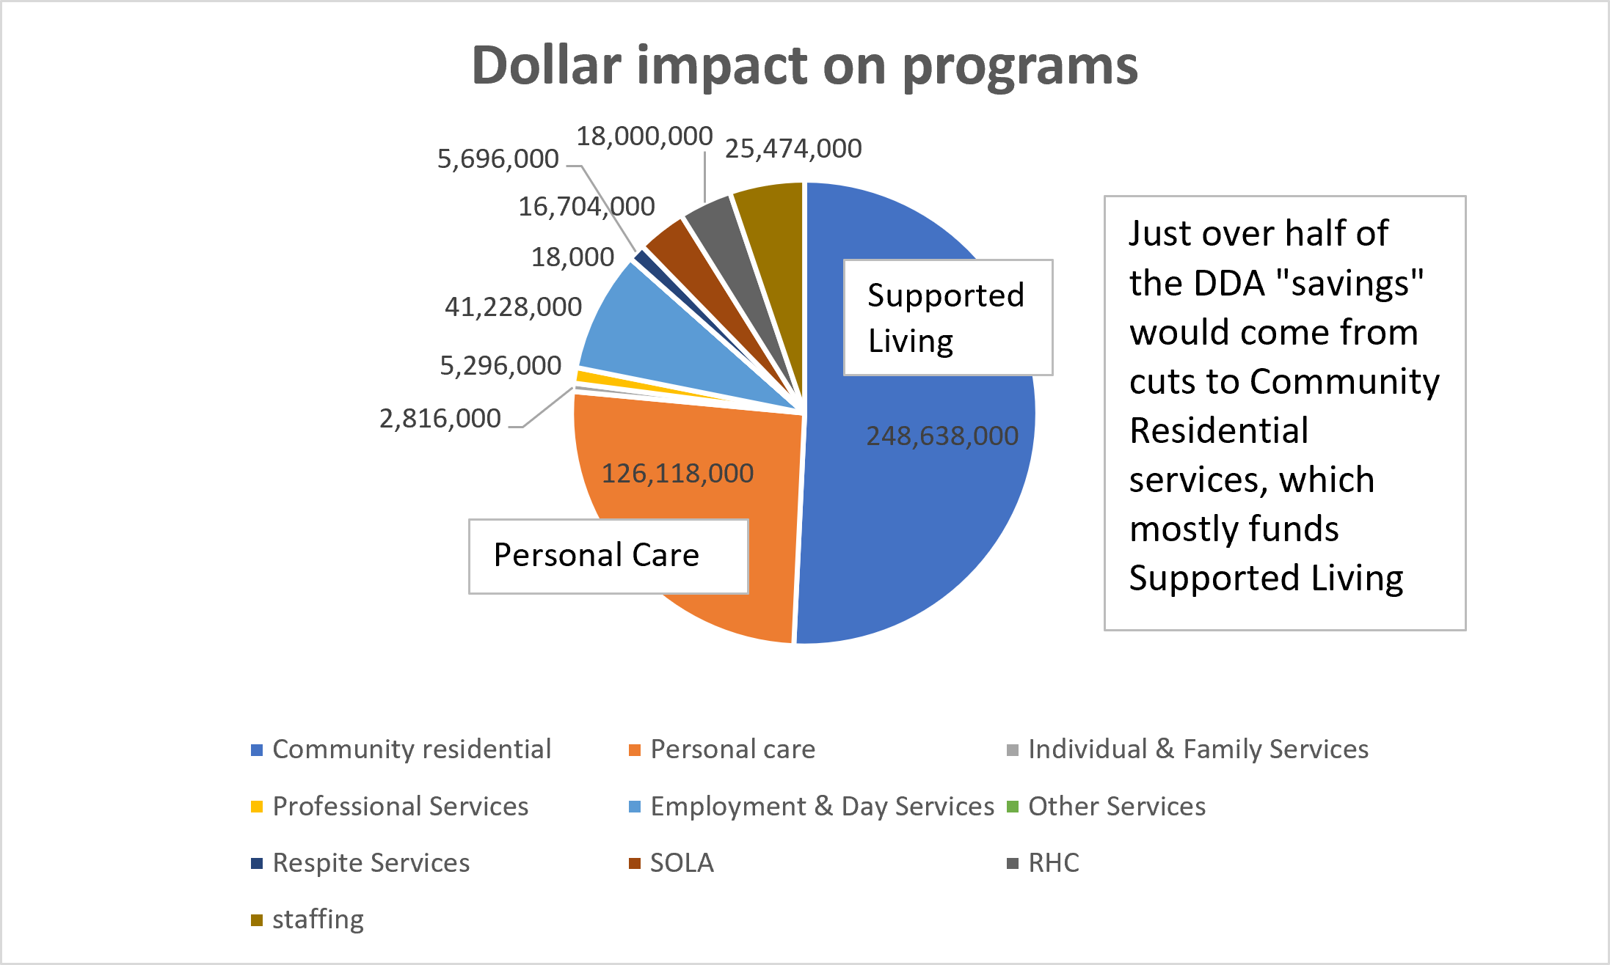

Slide 15
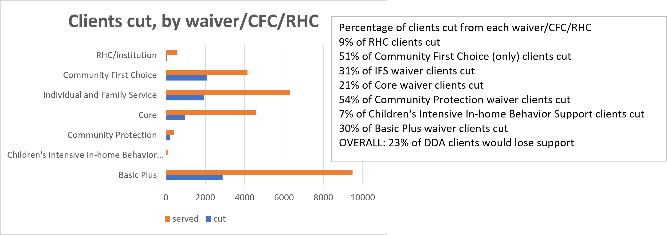

Slide 16
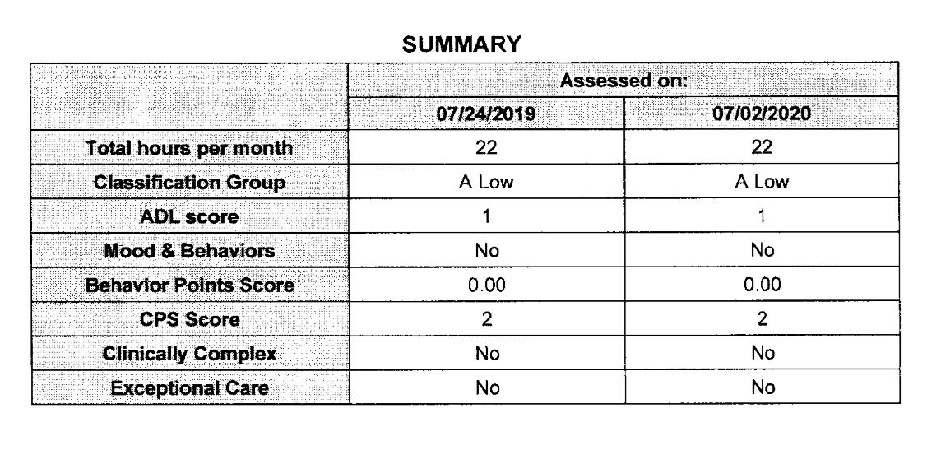
Models show people at risk of losing all support have “Classification Levels” up to E assessment. In this sample, the person is an A Low.

Slide 17
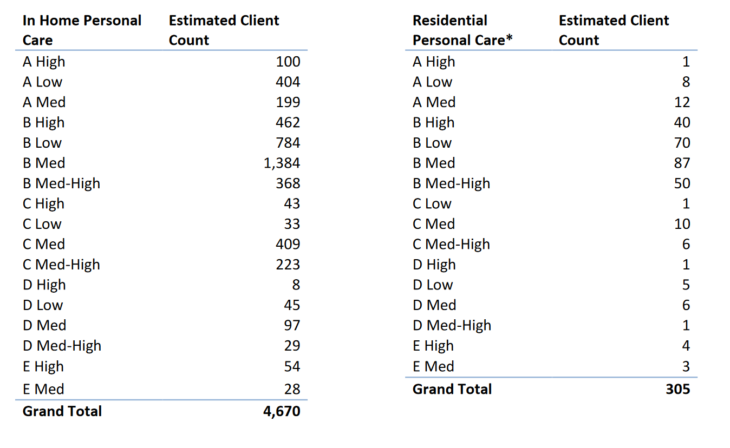
This shows the cuts DDA expects. They go as deep as E medium. What is not clear is what protects some clients rated E medium, but not others. DDA uses Intermediate Care Facility for Individuals with Intellectual Disabilities Level of Care (ICF/IID LOC), and/or the Nursing Facility Level of Care assessments

Slide 18
Client eligibility proposals: https://arcofkingcounty.org/file_download/6ba424a1-3d83-48a7-81cd-69eb1ccab19e
This shows the Supported Living and Group Home classifications for Community Residential; they show cuts up to level 6

Slide 19
Curious about the DDA caseload? https://www.dshs.wa.gov/sites/default/files/DDA/dda/documents/2020%20DDA%20Caseload%20and%20Cost%20Report.pdf

Slide 20
ALTSA RATIONALE
Eliminated Medical Personal Care program
Added additional activities for daily living requirement (for most, from 3 to 4)
Most impacts people whose need for services are primarily due to cognitive support (behavioral health, traumatic brain injury, early diagnosis of dementia, etc)

Slide 21
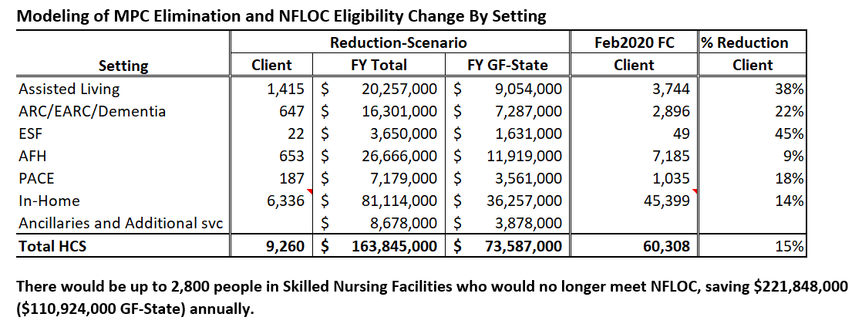
This shows where ALTSA sees cuts coming from. (ESF = Enhanced Services Facility. HCS = Home and Community Services)

Slide 22
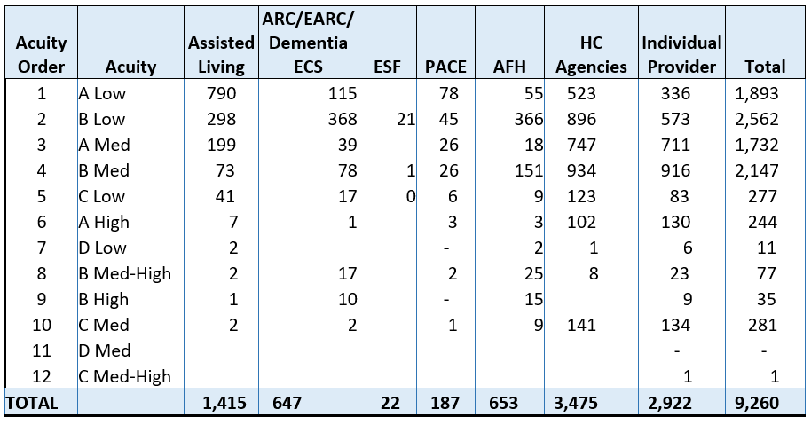
ALTSA acuity levels and cuts. These go to C Medium. ALTSA uses the Nursing Facility Level of Care assessment

Slide 24
Is There Help?
There is some federal stimulus money, but there are lots of rules about what it can be used for
There is state money set aside for emergencies, but there is not enough to fix the problem

Slide 25
Is There Help?
Advocates asked Congress to fund more home and community-based services. These are another name for DDA waiver services.
So far, Congress has not increased those funds.

Slide 26
OTHER Cuts: Reduce provider rates
In-home providers
Adult Family Homes
Employment support and community integration
Destabilizes workforce

Slide 27
OTHER CUTS: Close a Residential habilitation center
Options include: Reduce staff positions, consolidate cottages; and close Rainier School entirely.
Closing Rainier and transitioning clients costs more in FY21, but leads to savings in the next biennium

Slide 28
OTHER CUTS: Staffing costs
Affects state DDA employees, not DSPs
Unpaid furlough days. Now in effect

Slide 29
optional MediCaid SERVICES AT RISK
Adult dental
Interpreter services
Therapies: OT/PT/ST
Hospice, breast and cervical cancer treatment, and more

Slide 30
You can’t SHRED safety nets
Safety nets catch people, so they don’t fall into crisis
Supports help people build connections and resiliency
When you cut holes in nets, lots of people fall through
ALL SERVICES ARE CRITICAL – even if support means just a few hours a week. When you cut “low touch” support, you push people into another “system,” such as homelessness response.

Slide 31
No Decisions, Yet
State leaders have not decided, yet, to pull people off long-term supports
But we are worried they will make it more difficult for people to get the support they need to live and be a part of their community

Slide 32
Questions?

Slide 33
We Need Your Help
We want to make sure people who cut supports understand they will hurt people with intellectual and developmental disabilities, their families, and the workers who support them
You can help: Share your story. Be loud.

Slide 34
CONTACT YOUR STATE LEGISLATORS
At a minimum, send each of them a note. You can also ask to meet with them. Plan on several letters/calls:
NOW
When the governor releases his budget proposal (mid-December to January)
Midway through session (mid-February)
Toward end of session, when budget negotiations heat up (End of March)

Slide 35
Resource to share
https://arcofkingcounty.org/file_download/2a30b8f1-4b5f-4f03-bb57-56c7bf479de

Slide 36
Some Talking points
41st … and falling? Washington’s system of supports for people with developmental disabilities is fragile and inadequate, serving less than 30 percent of the people it should. The DDA budget is built off current expenses, not on increasing or unmet need, or even on numbers who qualify. Our state is 41st in spending, has high case manager ratios (1 to 75), and already rations care, leaving thousands waiting for essential access to health, housing, education, and jobs.
15% cuts are really 30% once you factor in loss of matching federal dollars. And the impact can feel even greater. Demand for housing, food, behavioral health supports, and emergency care all jump when DD supports are cut.
Deepest poverty. People with a cognitive /behavioral disability face the highest rates of poverty in the state. These folks make up the core of people with developmental disabilities. For those who rely on them, supports are so much more than safety and security:
Personal care literally means being able to get out of bed
Residential support means access to a home
Employment support means access to jobs
The domino effect. When people secure a waiver through DDA they also secure Medicaid Apple Health, food benefits, and - in King County - possibly mental health support via Sound. Home and job are often directly tied to supports.
One event away from crisis. ALL clients need the support. Whether they need just 1 support once a week, or several 24/7, that support is what is keeping them – and their families – out of crisis.
Arbitrary. The models show people at the highest classification levels losing all support. When asked which factors determined winners and losers, DDA could not answer.
Ending chronic homelessness saves taxpayers money. In King County, we know about two-thirds of the homeless population has a disability, and national research shows 30 to 40 percent of people experiencing homelessness have an intellectual disability. Research also shows that providing supportive housing cuts costs to society by almost half. So why would the state cut the supports that keep people with DD (and often their families) out of chronic homelessness?

Slide 37
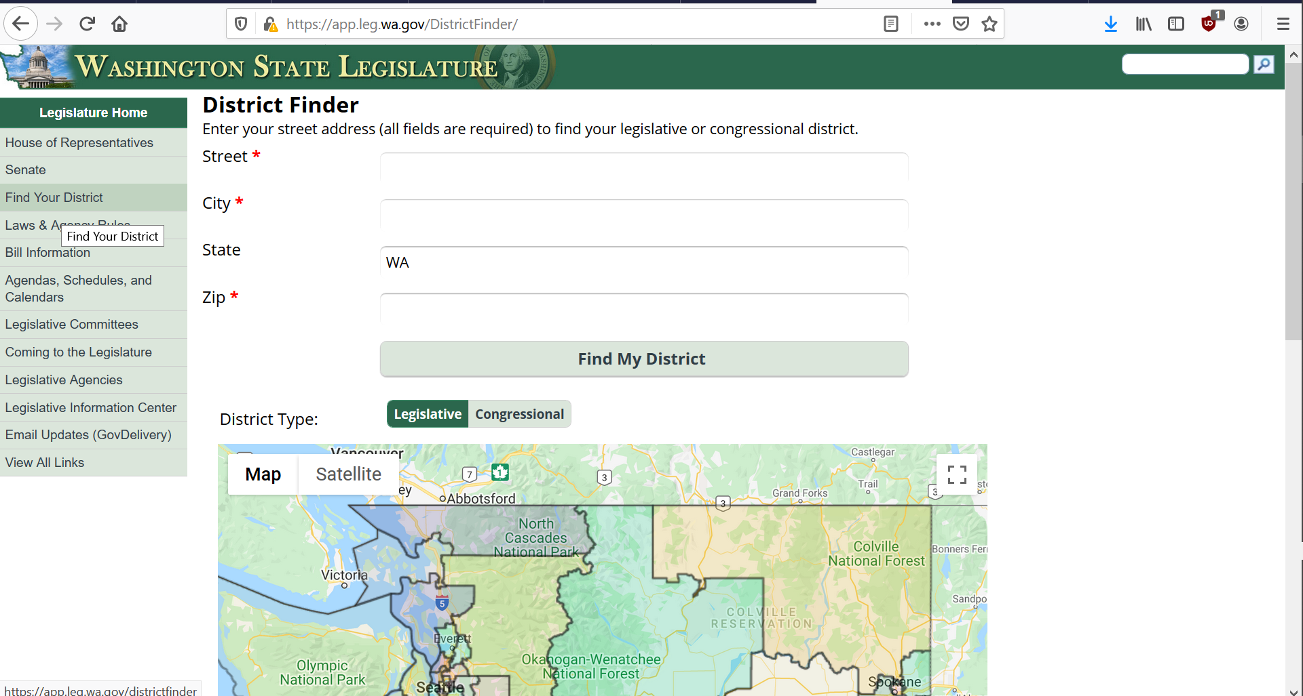
What to do? Contact legislators
We want to make sure people who cut supports understand they will hurt.
https://app.leg.wa.gov/DistrictFinder/

Slide 38
What can you do?
We want to make sure people who cut supports understand they will hurt.
Let leaders know cuts would be devastating
Also …
Contact the governor
Be an informed voter
The Arc of WA action alerts: https://arcwa.org/action-center/
https://app.leg.wa.gov/DistrictFinder/

Slide 39
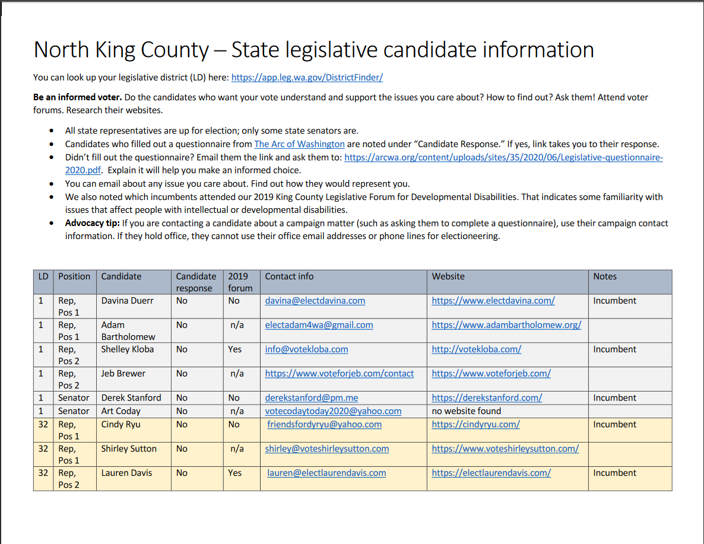
Be an informed voter
https://arcofkingcounty.org/advocacy/be-an-informed-voter.html
This link will take you to page with resources to reach out to legislative candidates

Slide 40
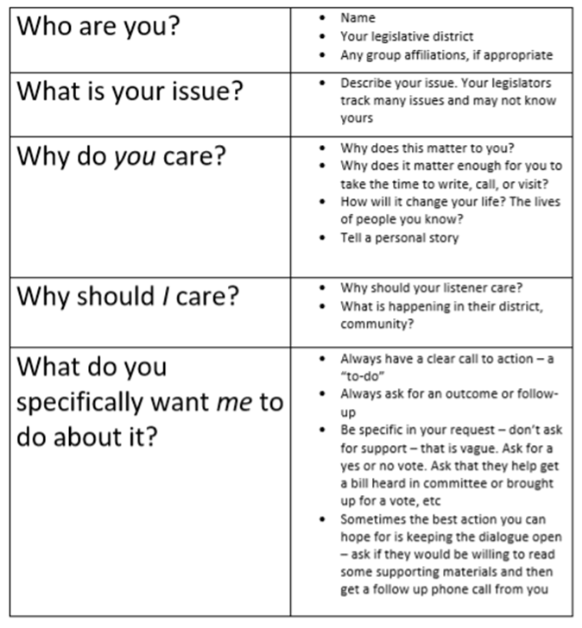
What to say?
We want to make sure people who cut supports understand they will hurt.
How to contact your legislator: https://arcofkingcountyvoice.blogspot.com/2020/09/how-to-contact-your-legislator-and-what.html
Sample messages: https://arcwa.org/action-center/ (click on Cuts Cause Crisis and Petition to the Governor)

Slide 41
Stay in touch
Sign up for advocacy newsletters, https://signup.e2ma.net/signup/1894973/1898164/ Advocacy resources:
King County Parent and Family Coalition, general advocacy for DD issues
Community Change Champions, advocacy support for people with disabilities
Robin Tatsuda​
Executive Director​
rtatsuda@arcofkingcounty.org​
206.829.7011
Ramona Hattendorf​ Director of Advocacy​
rhattendorf@arcofkingcounty.org​
206.829.7048

