Slide 2
Facilitators:
Tanka Aden Taylor Crisp
Ramona Hattendorf

Slide 9
Notes:
We asked what people are most worried about right now.
1 - Access to support All kinds. Residential, employment, early supports, day programs.
2 - Care workforce issues No providers, wrong skills set, low pay, problems working with DDA
3 - Disability equity
Ableism; ADA accommodations; inclusion/accessibility; safety; economic well-being and food stability; personal wellbeing; difficulty finding and retaining jobs
Other themes included housing, support for family caregivers, health care, education, and transportation
Some subgroups had other concerns.

Slide 10
Notes:
Most people who took the survey got services through DDA. But 35% did NOT, and another 6% weren’t sure. It is good to remember that DDA 1) doesn’t support a lot of people who identify as part of the IDD community, and 2) only offers some services – not all – that people with IDD and their families may need

Slide 11
We listed some specific issues and asked how big a concern each was
Most selections for BIG concern:
A safe, affordable place to live
Support to live in the community and participate in work or activities
Good mental health services or other behavior support
Weighted average for BIG concern:
Support to live in the community and participate in work or activities
A safe, affordable place to live
(Tied) Access to community activities, and support for family caregivers
Again, these varied among subgroups. For people with disabilities, weighted average:
Stable finances
(Tied) A safe, affordable place to live, and support to live in the community and participate in work or activities
Good mental health services or other behavior support
For non-white respondents, weighted average:
Good education
Good mental health services or other behavior support
Stable finances

Slide 12
Notes:
Again – different issues rose to the top when looking at subgroups. It is important to remember we don’t have the same experiences in the IDD community. People with disabilities and were less concerned about DDA supports and more about financial stability, health, and education. Same with respondents who were BIPOC. Family support was a bigger concern among people who took the survey in Spanish

Slide 30
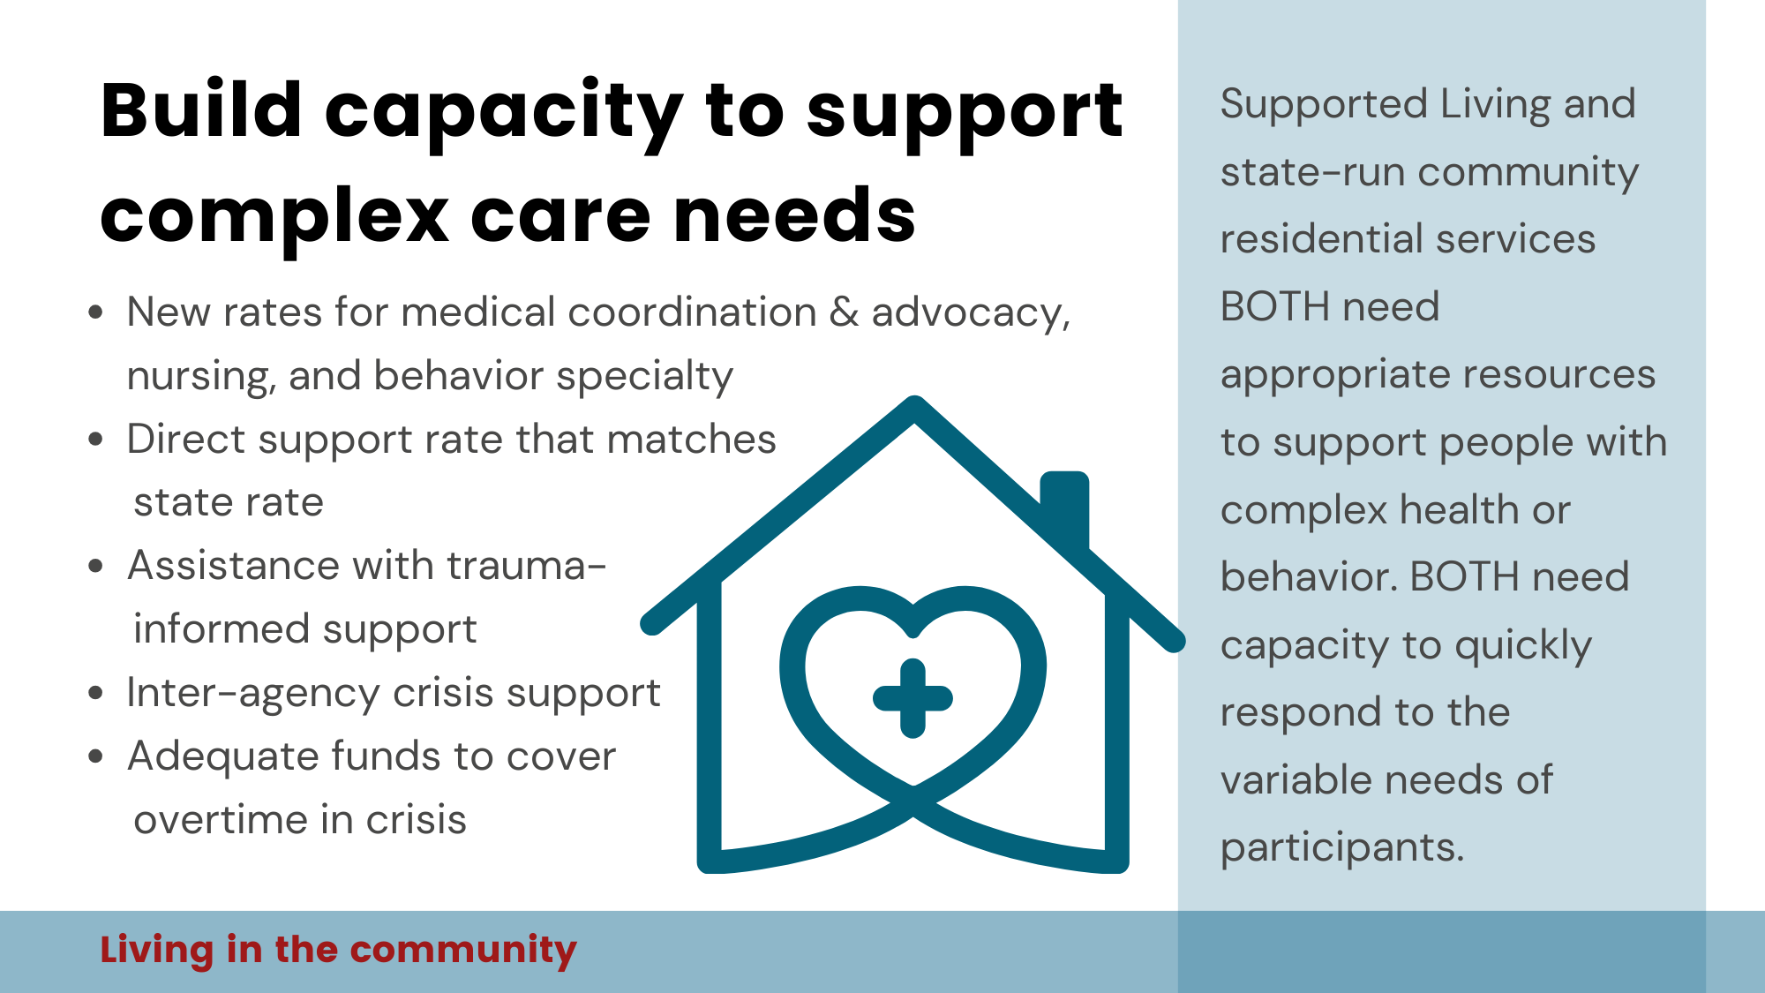

Slide 31
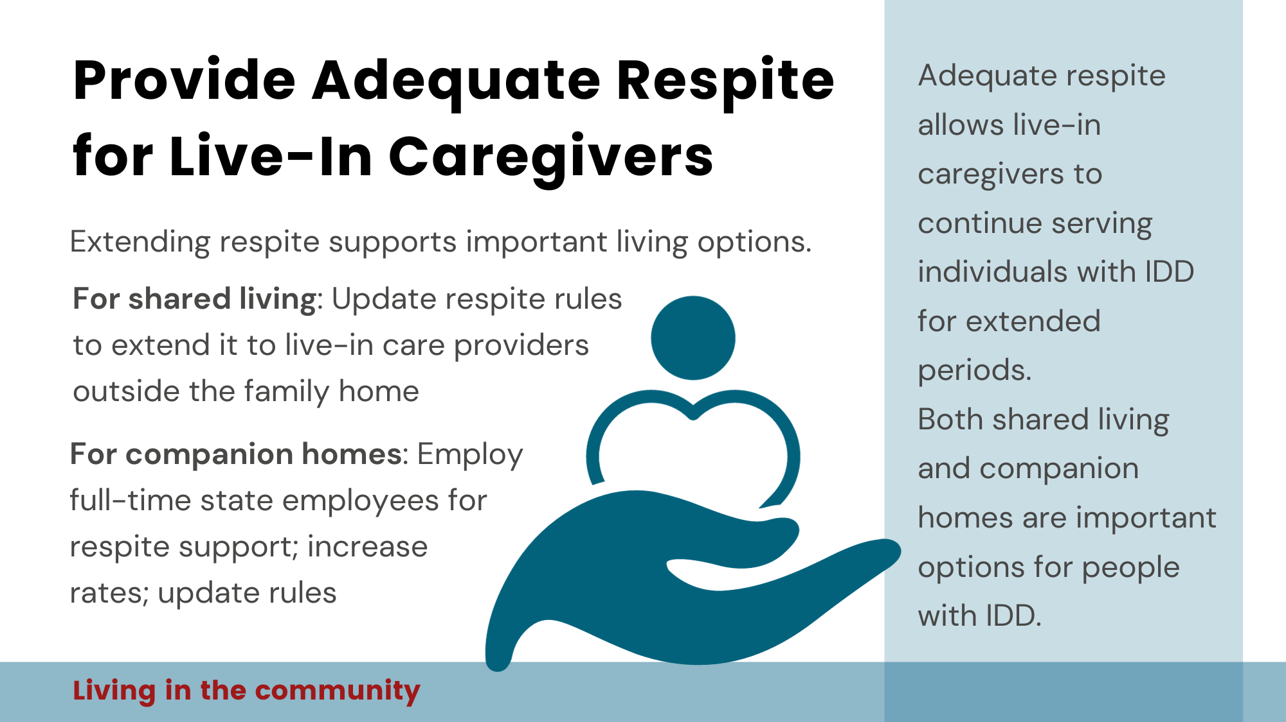

Slide 47
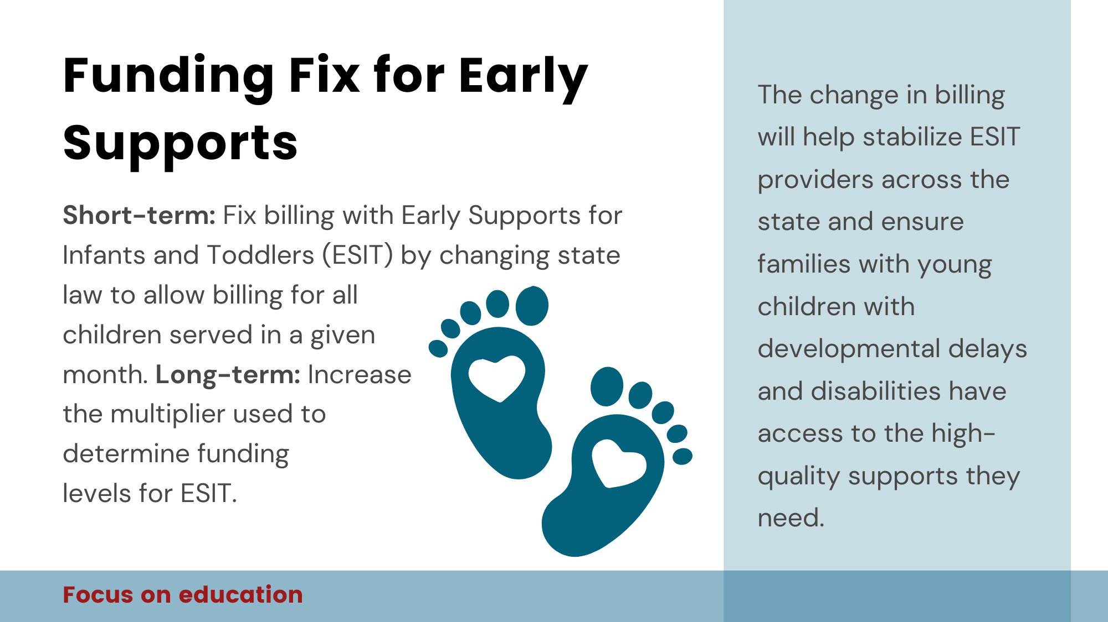

Slide 49
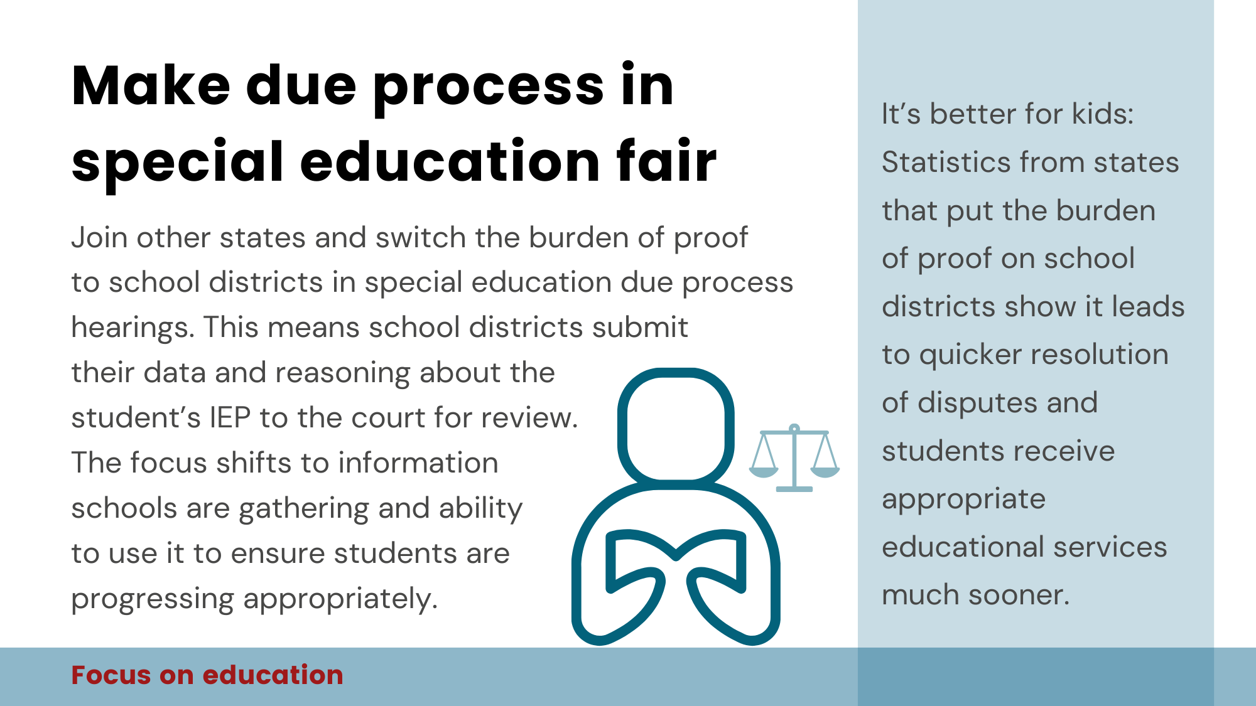

Slide 50
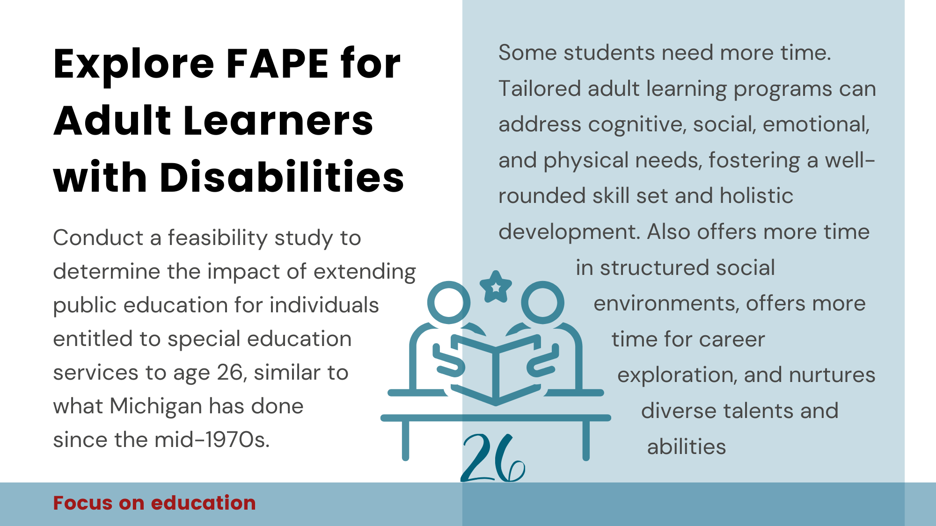

Slide 53
January 10
January 17
January 24
January 31
February 7
February 14
February 21
February 28
What Are Our Rights and How Do We Advocate?
What Do People Need to Live in their Community?
How Do We Create Safe, Affordable Places to Live?
How Do We Support Families to Support their Loved Ones?
What is Needed to Ensure Every Student has an Inclusive Educatiion?
Engaging in Our Communities – How Do We Make Our Communities Welcoming?
Why are so Many People in Crisis?
What Can You Do Now?
Advocacy Days begins at 10 a.m. on Wednesdays during the 2024 legislative session
Spanish translators will be provided
Contact Bean@arcwa.org to request other languages or accommodations
Notes:
During session, we meet Mondays at 9 am to go over bills of interest and hearings. The monthly big group meetings will start again in April, after session ends in March. There will be monthly meetings to discuss strategic planning work.

